Slide 1
FUNCTIONALITY
For Measuring Functionality of software we examine 3
Approaches
1) Albrecht’s function point analysis
2) De Marco’s specification weight
3) COCOMO 2.0 approach to object points
1) Albrecht’s approach for effort estimation
Function points are intended to measure the amount of
functionality in a system as described by a specification
To compute FP, first compute unadjusted function point count
(UFC)

Slide 2
To compute UFC, we have to determine the number of items
of following types :
1) External Inputs Those items provided by user that describe
distinct application oriented data (file names & menu
selections) These items do not include inquiries
2) External outputs Reports & Messages on screen
3) External Inquiries Interactive inputs requiring a response
4) External files Machine-readable interfaces to other systems
5) Internal files Logical master files in the system
Weighting Factor
Item Simple Average Complex
-----------------------------------------------------------------
Ext inputs 3 4 6
Ext outputs 4 5 7
Ext inquiries 3 4 6
Ext files 7 10 15
Int files 5 7 10

Slide 3
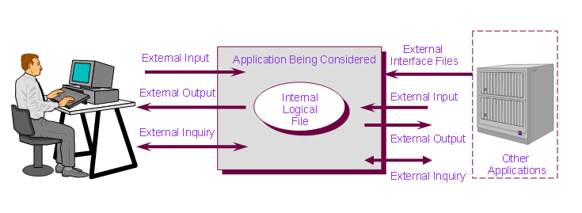
FP-Based Estimation
FPA functional units

Slide 4
Example : Computing basic function point components from
specification
Spell checker specification
The checker accepts as input a document file and an optional
Personal dictionary file. The checker lists all words not
contained in either of these files. The user can query the
number of words processed and the number of spelling
errors found at any stage during processing
Errors found enquiry
# Words Processed message
Words process enquiry
Spelling
checker
User
# Errors Message
Document File
User
Personal Dictionary
# Report on misspelled words
Dictionary Words

Slide 5
A=2
B=3
C=2
D=2
E=1

Slide 6
There are 2 external inputs – document file and personal
A = 2 dictionary file
Three external outputs B = 3 misspelled word report
number of words processed message
number of errors message
C = 2 External inquiries Words processed
Errors so far
D = 2 External files document file & Personal dictionary
E = 1 Internal file Dictionary file
Each item is assigned a subjective complexity as simple,
Average or complex.
Here we assume the complexity for each item is average
UFC= 4A + 5B + 4C + 10D + 7 E
UFC = 4(2) + 5(3) + 4(2) + 10(2) + 7(1) = 58

Slide 7
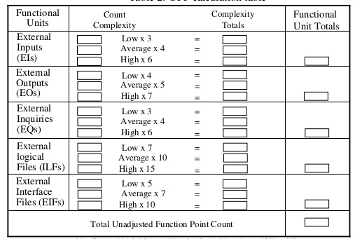
FP-Based Estimation
Unadjusted Function Points (UFP)
UFP Calculation table

Slide 8
If for example, dictionary file and misspelled word report
Are complex then UFC will change as :
UFC = (4(1)+6(1)) + (5(2)+7(1)) + 4(2) + (10(1)+15(1)) + 10(1) = 70
To compute function points, we calculate adjusted function
Point count FP. FP = UFC X Technical complexity factor
(TCF)
TCF involves 14 contributing factors
Each factor in table is rated from 0 to 5, where 0 means
that factor is irrelevant and 3 means average, 5 means it is
essential to systems being built.
14
TCF = 0.65 + 0.01 Σ F_{i}
i=1

Slide 9
F1 : Reliable backup and Recovery
F2 : Data Communications
F3 : Distributed functions
F4 : Performance
F5 : Heavily used configuration
F6 : Online Data entry
F7 : Operational Ease
F8 : Online Update
F9 : Complex interface
F10 : Complex processing
F11 : Reusability
F12 : Installation ease
F13 : Multiple Sites
F14 : Facilitate change

Slide 10
For given example F3, F5, F9, F11, F12, F13 are 0
F1, F2, F6, F7, F8 ANF F14 ARE 3 and that
F4 and F10 are 5
Hence TCF = 0.65 + 0.01 (18 + 10) = 0.93
UFC = 70 (Already calculated)
FP = 70 x 0.93 = 65 Function Points
Suppose our historical database or project measurements
reveals that it takes a developer an average of 2 person
Days of effort to implement a function point, then we may
Estimate the effort needed to complete the spelling
Checker as 65 x 2 = 130 person days
or 4.3 work months.

Slide 11
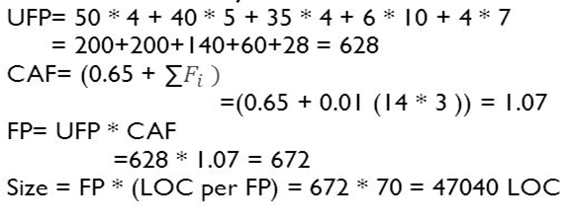
FP-Based Estimation – An Example (cont..)
  Consider a project with the following functional units:
  Number of user inputs = 50
  Number of user outputs = 40
  Number of user enquiries = 35
  Number of user files = 06
  Number of external interface = 04
  Assume all complexity adjustment factors and weighting factors are average. Compute function points for the project. Suppose that program needs 70 LOC per FP. Find out the size of complete project

Slide 12
Exercises:
  2. Consider a project with the following parameters
    External Inputs: 10 with low complexity, 15 with average complexity, 17 with high complexity
    External Outputs: 6 with low complexity, 13 with high complexity
    External Inquiries: 3 with low complexity, 4 with average complexity, 2 with high complexity
    Internal logical files: 2 with average complexity, 1 with high complexity
    External Interface files: 9 with low complexity
    In addition to above, system requires
    Significant data communication
    Performance is very critical
    Designed code may be moderately reusable
    System is not designed for multiple installations in different organizations
    Other complexity adjustment factors are treated as average. Compute the function points for the project

Slide 13
Exercises:
  3. An application has the following; 10 low external inputs, 12 high external outputs, 20 low internal logical files, 15 high external interface files, 12 average external inquiries and a value of complexity adjustment factor 1.10. What are the unadjusted and adjusted function point counts?

Slide 14
Function points are also used in other ways as a size Measure
We can express defect density in terms of defects per
function point
2) They are also used in contracts, to report progress and to
define payment
50% to 60% software contracts in Netherlands have their
Costs tied to function-points specification.
3) Price per function point may be fixed during software
contracts
4) We track project completion by reporting number of
function points specified, designed, coded and tested

Slide 15
COCOMO 2.0 approach (a model for predicting effort)
Object points was selected for size input
To compute Object Points, an initial size measure is generated
by counting number of screens, etc.
Next each object is classified as simple, medium and
Difficult as per given guidelines
Object point complexity levels
For Screens
Number and source of data tables
Number of views Total < 4 Total < 8 Total 8+
Contained (<2 server, (2-3 server, (>3 server
<2 client) (3-5 client) >5 client)
< 3 simple simple medium
3-7 simple medium difficult
8+ medium difficult difficult

Slide 16
For Reports
Number and source of data tables
Number of sections Total < 4 Total < 8 Total 8+
Contained (<2 server, (2-3 server, (>3 server
<2 client) 3-5 client) > 5 client)
0 or 1 simple simple medium
2 or 3 simple medium difficult
4+ medium difficult difficult
The number in each cell is weighted according to the given
Table
Object Type Simple Medium Difficult
Screen 1 2 3
Report 2 5 8
4GL component -- -- 10
(4GLs such as SAS, SPSS, Stata, ORACLE, etc)

Slide 17
The weight reflect the relative effort required to implement an
Instance of that complexity level.
Then weighted instances are summed to yield a single
Object-point number.
Then Re-use is taken into account.
Assuming that r% of objects will be reused from previous
Projects, the number of new object points is calculated
to be
New Object points = (object points) x (100 – r) / 100
To use this number for effort estimation, COCOMO 2.0
Determines a productivity rate (i.e new object points per
Person month) from a table based on developer experience
and capability.

Slide 18
Example :
Suppose 840 object points are computed from a system
Specification and 20% can be supplied by existing
Components the
NOP= 840 x (100 – 20) / 100 = 672 object points
Object Points effort conversion table
Developer’s experience | Very Low | Low | Nominal | High | Very High
Productivity Factor | 4 | 7 | 13 | 25 | 50
In our example, productivity is nominal
Effort = 672 / 13 = 52 Months

